Slide 1

Summer Project
Review of course outline
Building a presentation
Discussion

Slide 2
Due on Tuesday
1- Decide how you will present your project
2- Journal: My school experience (200 – 250 words)
3- Define: Pedagogy, curriculum, school, learning,
student, teacher
1- write down what you think it is
2- research and choose a good defn.
3- create your own new definition
4- Find examples of 4 outdoor schools (google/
youtube). Copy down links, make notes, and be prepared
to talk about them on Wednesday.
Submit your work before 11 PM on Tuesday

Slide 3
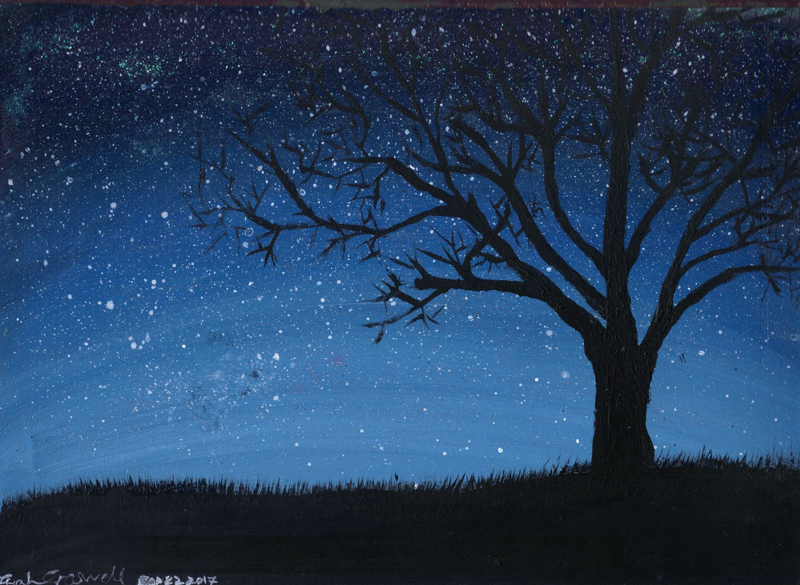
Example
Classroom : 1- a place were people go to learn
2-
3- anywhere that learning takes place
a learning space, a room in which both children and adults learn. (wikipedia)

